Slide 1
Planning for Security
Information Security

Slide 2
Outline
Introduction
Governance
Information Security Policy, Standards, and Practices
NIST Framework

Slide 3
Introduction
Creation of an information security program begins with:
Creation or review of an organization’s information security policies, standards, and practices
Selection or creation of information security architecture and a detailed information security blueprint
Without policy, blueprints, and planning, an organization is unable to meet the information security needs of various communities of interest
Organizations undertake at least the following plans:
Strategic planning
Contingency planning
Notes:
An information security blueprint is a strategic, comprehensive, and scalable plan that outlines an organization's security requirements, policies, and technical controls to protect assets. It translates high-level security strategies into actionable, prioritized steps—such as risk management, employee training, and infrastructure, network, and data protection—to align with business objectives.
A strategic plan defines an organization's long-term goals and direction, while a contingency plan provides alternative, "Plan B" actions to ensure business continuity if unforeseen events (e.g., crises, market shifts) disrupt the primary strategy.

Slide 4
Information Security Planning and Governance
Governance
Set of responsibilities and practices exercised by the board and executive management
Goal to provide strategic direction, ensuring that objectives are achieved
Determining that risks are managed appropriately and verifying that the enterprise’s resources are used responsibly
Notes:
Governance is the framework by which organisations are directed and controlled. It identifies who can make decisions, who has the authority to act on behalf of the organisation and who is accountable for how an organisation and its people behave and perform.

Slide 5
Information Security Planning and Governance Outcomes
Information Security Governance outcomes
Strategic
Aligned Risk management
Resource management
Performance measure

Slide 6
Information Security Policy, Standards, and Practices
Policy: course of action used by organization to convey instructions from management to those who perform duties Policies are organizational laws
Standards: more detailed statements of what must be done to comply with policy
Practices, procedures, and guidelines effectively explain how to comply with policy
For a policy to be effective, it must be properly disseminated, read, understood, and agreed to by all members of organization and uniformly enforced

Slide 7
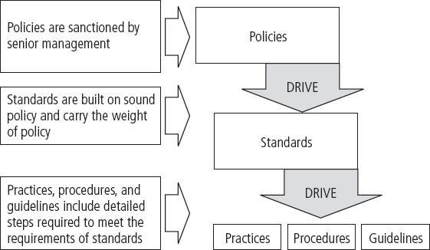

Slide 8
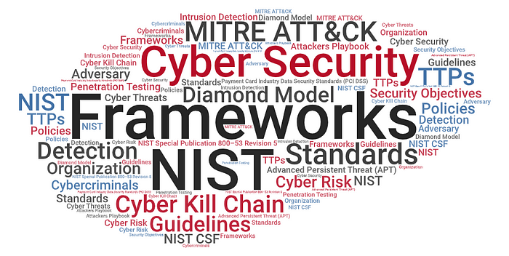
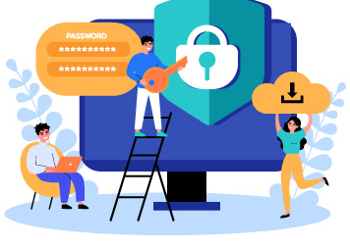
NIST Cybersecurity Framework

Slide 9
Outline
NIST Cybersecurity Framework
Framework Core Structure
Functions
Categories
Tiers

Slide 10
What is the NIST Cybersecurity Framework?
The National Institute of Standards and Technology (NIST) is a non-regulatory agency that promotes innovation by advancing measurement science, standards, and technology.
The NIST Cybersecurity Framework (NIST CSF) consists of standards, guidelines, and best practices that help organizations improve their management of cybersecurity risk.
The NIST CSF is designed to be flexible enough to integrate with the existing security processes within any organization, in any industry.
It provides an excellent starting point for implementing information security and cybersecurity risk management in virtually any private sector organization in the United States.

Slide 11
NIST Cybersecurity Framework core structure
NIST Cybersecurity Framework includes functions, categories, subcategories, and informative references.
Functions give a general overview of security protocols of best practices.
Functions are not intended to be procedural steps but are to be performed “concurrently and continuously to form an operational culture that addresses the dynamic cybersecurity risk.”
Categories and subcategories provide more concrete action plans for specific departments or processes within an organization.

Slide 12
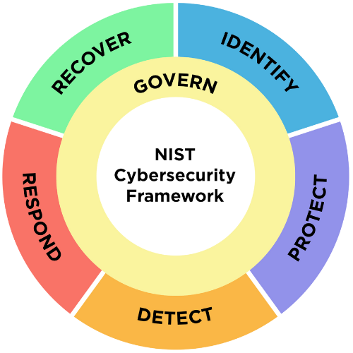
NIST Cybersecurity Framework core structure

Slide 13
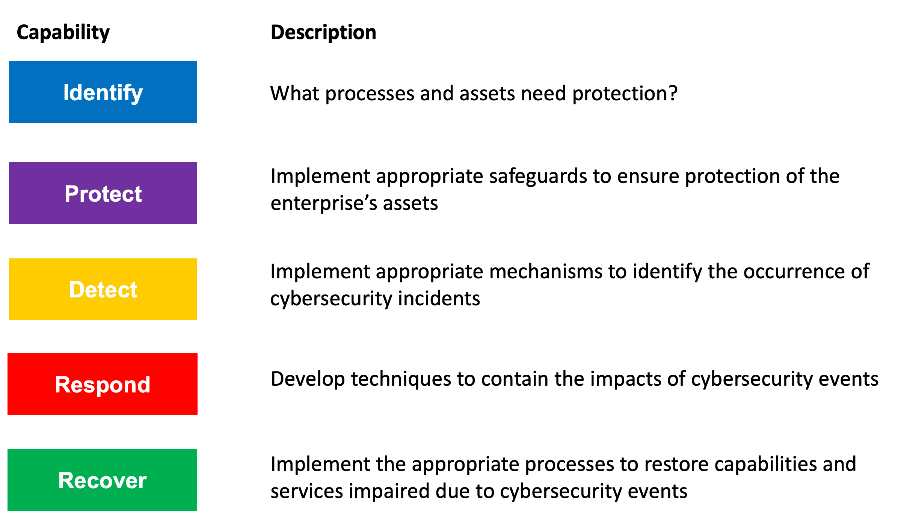
NIST Cybersecurity Framework core structure

Slide 14
NIST functions and categories
Identify: To protect against cyberattacks, the cybersecurity team needs a thorough understanding of what are the most important assets and resources of the organization.
The identify function includes such categories as asset management, business environment, governance, risk assessment and risk management strategy.

Slide 15
NIST functions and categories
Protect:
The protect function covers much of the technical and physical security controls for developing and implementing appropriate safeguards and protecting critical infrastructure.
These categories are identity management and access control, awareness and training, data security, information protection processes and procedures, maintenance, and protective technology.

Slide 16
NIST functions and categories
Detect:
The detect function implements measures that alert an organization to cyberattacks.
Detect categories include anomalies and events, security continuous monitoring, and detection processes.

Slide 17
NIST functions and categories
Respond:
The respond function categories ensure the appropriate response to cyberattacks and other cybersecurity events.
Specific categories include response planning, communications, analysis, mitigation, and improvements.

Slide 18
NIST functions and categories
Recover:
Recovery activities implement plans for cyber resilience and ensure business continuity in the event of a cyberattack, security breach, or other cybersecurity event.
The recovery functions are recovery planning improvements and communications.

Slide 19
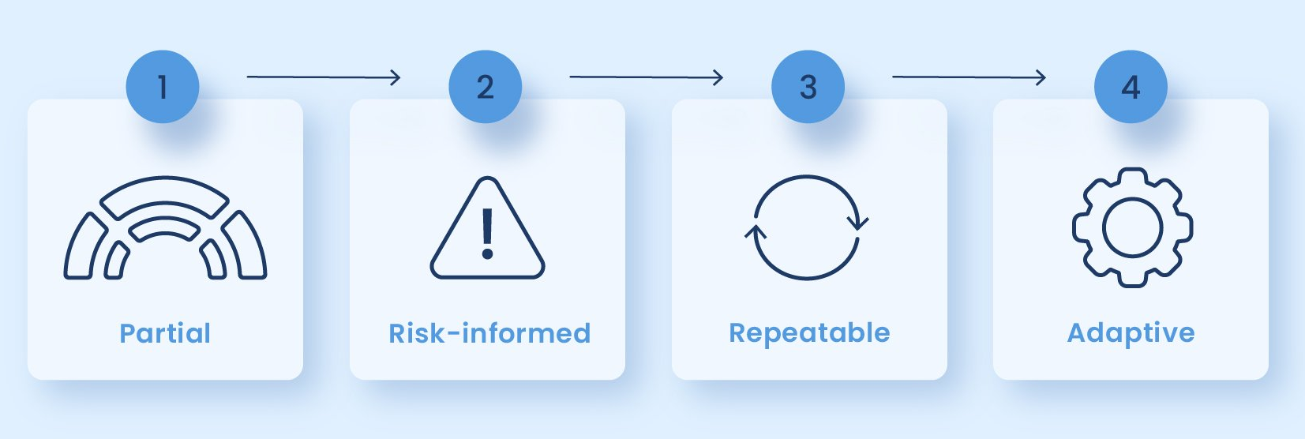
NIST Framework implementation tiers

Slide 20
NIST Framework implementation tiers
To help private sector organizations measure their progress towards implementing the NIST Cybersecurity Framework, the framework identifies four implementation tiers:
Tier 1 – Partial:
The organization is familiar with the NIST CSF and may have implemented some aspects of control in some areas of the infrastructure.
Implementation of cybersecurity activities and protocols has been reactive vs. planned.
The organization has limited awareness of cybersecurity risks and lacks the processes and resources to enable information security.

Slide 21
NIST Framework implementation tiers
Tier 2 – Risk Informed:
Tier 2 businesses recognize that cybersecurity risks exist and that they need to be managed.
However, they lack standard procedures and company-wide awareness of threats.
The organization is more aware of cybersecurity risks and shares information on an informal basis.
It lacks a planned, repeatable, and proactive organization-wide cybersecurity risk management process.

Slide 22
NIST Framework implementation tiers
Tier 3 – Repeatable:
Tier 3 organizations have developed and implemented procedures for managing cybersecurity risks. This includes incident response plans, security awareness training, and regular security assessments.
The organization and its senior executives are aware of cybersecurity risks.
They have implemented a repeatable, organization-wide cybersecurity risk management plan.
The cybersecurity team has created an action plan to monitor and respond effectively to cyberattacks.

Slide 23
NIST Framework implementation tiers
Tier 4 – Adaptive:
Continuously improving the organization's approach to managing cybersecurity risks. This includes making changes in response to incidents, new threats, and changing business needs.
The organization is now cyber resilient and uses lessons learned and predictive indicators to prevent cyberattacks.
The cybersecurity team continuously improves and advances the organization’s cybersecurity technologies and practices and adapts to changes in threats quickly and efficiently.
There is an organization-wide approach to information security risk management with risk informed decision-making, policies, procedures, and processes.
Adaptive organizations incorporate cybersecurity risk management into budget decisions and organizational culture.

Slide 24
Any Questions?

